Slide 1
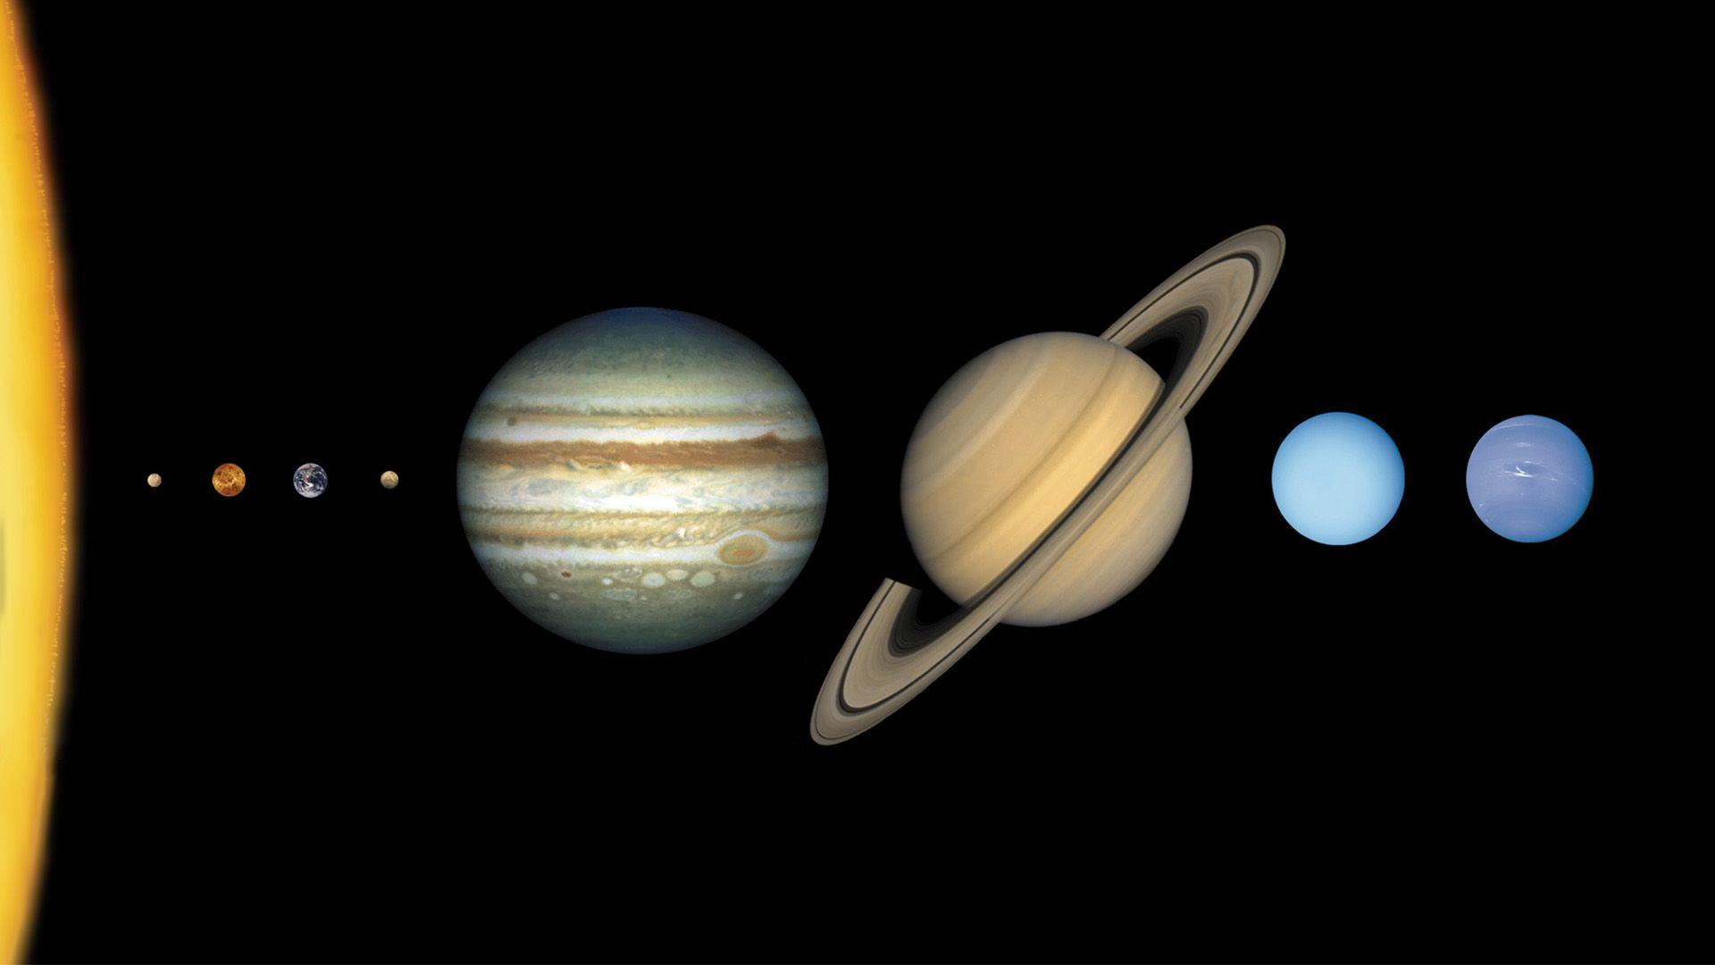
THE SOLAR SYSTEM
Capstone Project: Aidan Ayers

Slide 2

The Inspiration:
Space/Archaeology Exploration Game
Solar System Explorable with NO Loading Barriers
Engine to Model Newtonian and Kepler Laws
Artistic and Programming Marvel
Annapurna Interactive (2019)

Slide 3
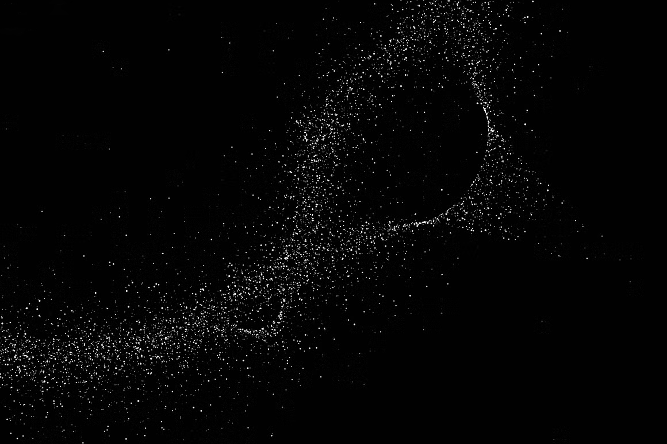
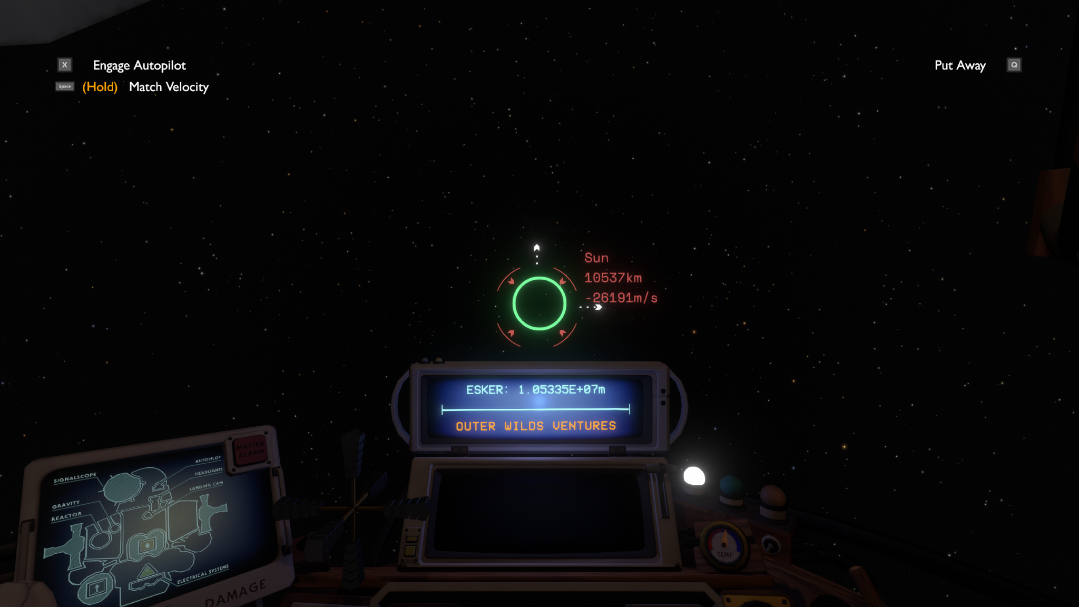
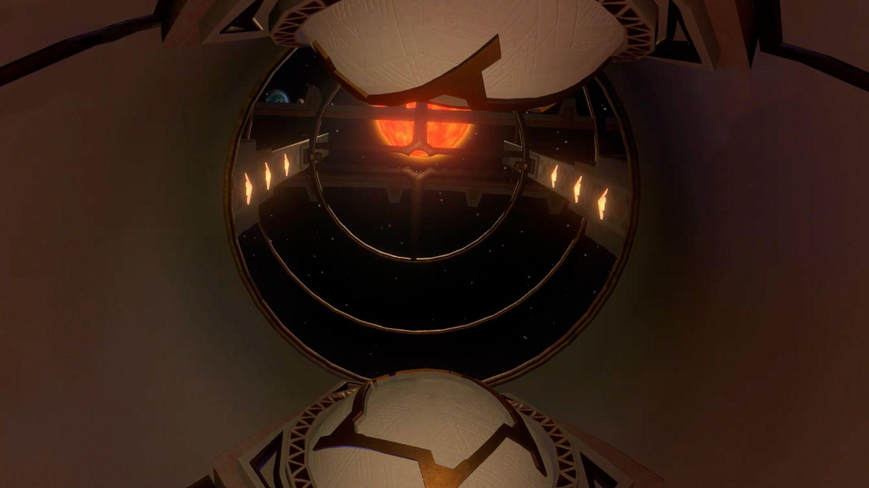
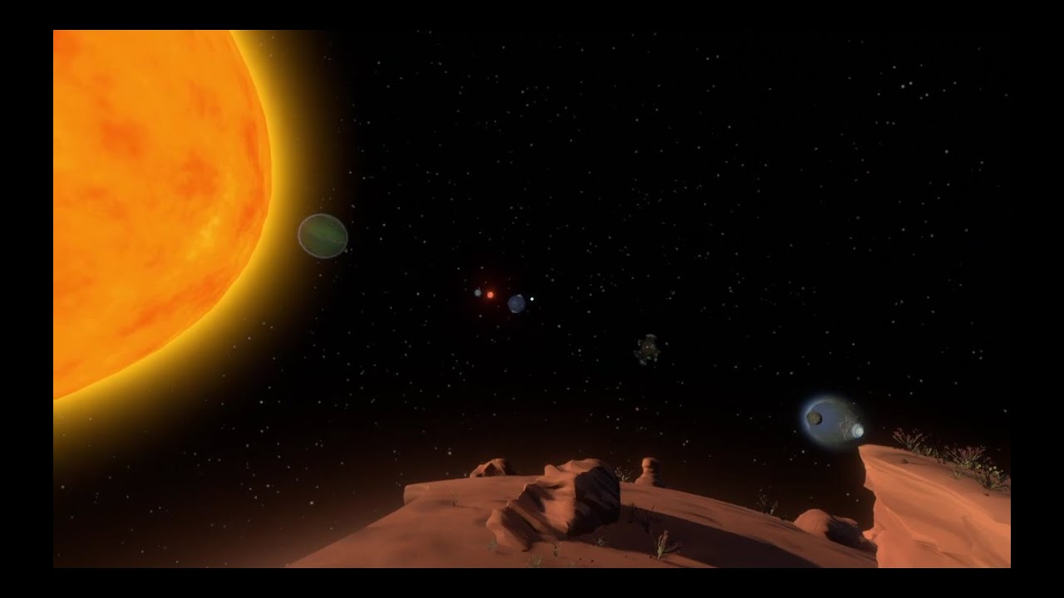
Signalscope
Active Skies
Black Hole Stations
Distance Tracking
Modelling Many Bodies
Planet Alignment
Signalscope and Scout Launcher allow you to see the distance from yourself and any planet in the games solar system
All planets are loaded in and moving at all times. Small scale allows you to see any planet with fine detail if you stand in the right place at the right time
The only method of fast travelling in Outer Wilds. Requires planets to be in line with one another, which takes different times depending on which planet you are waiting to align with.

Slide 4
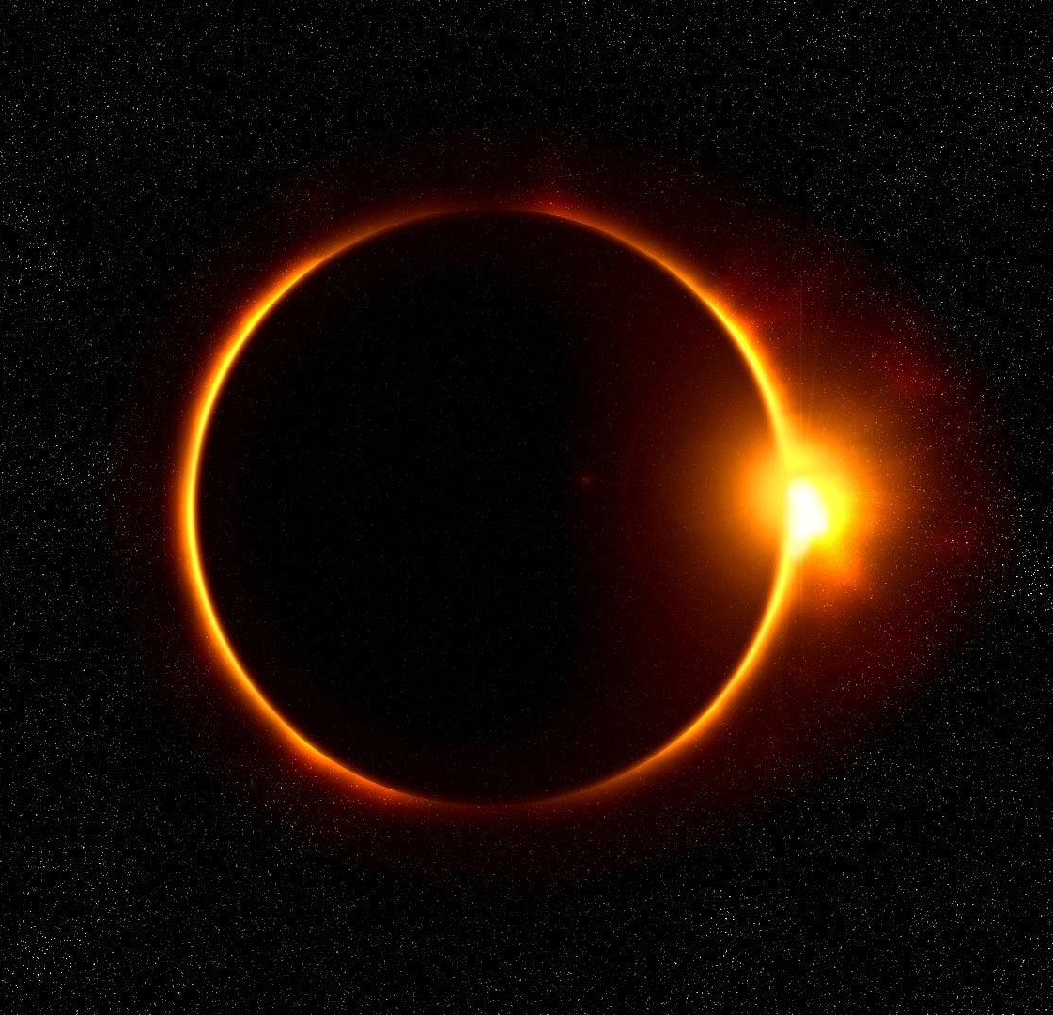
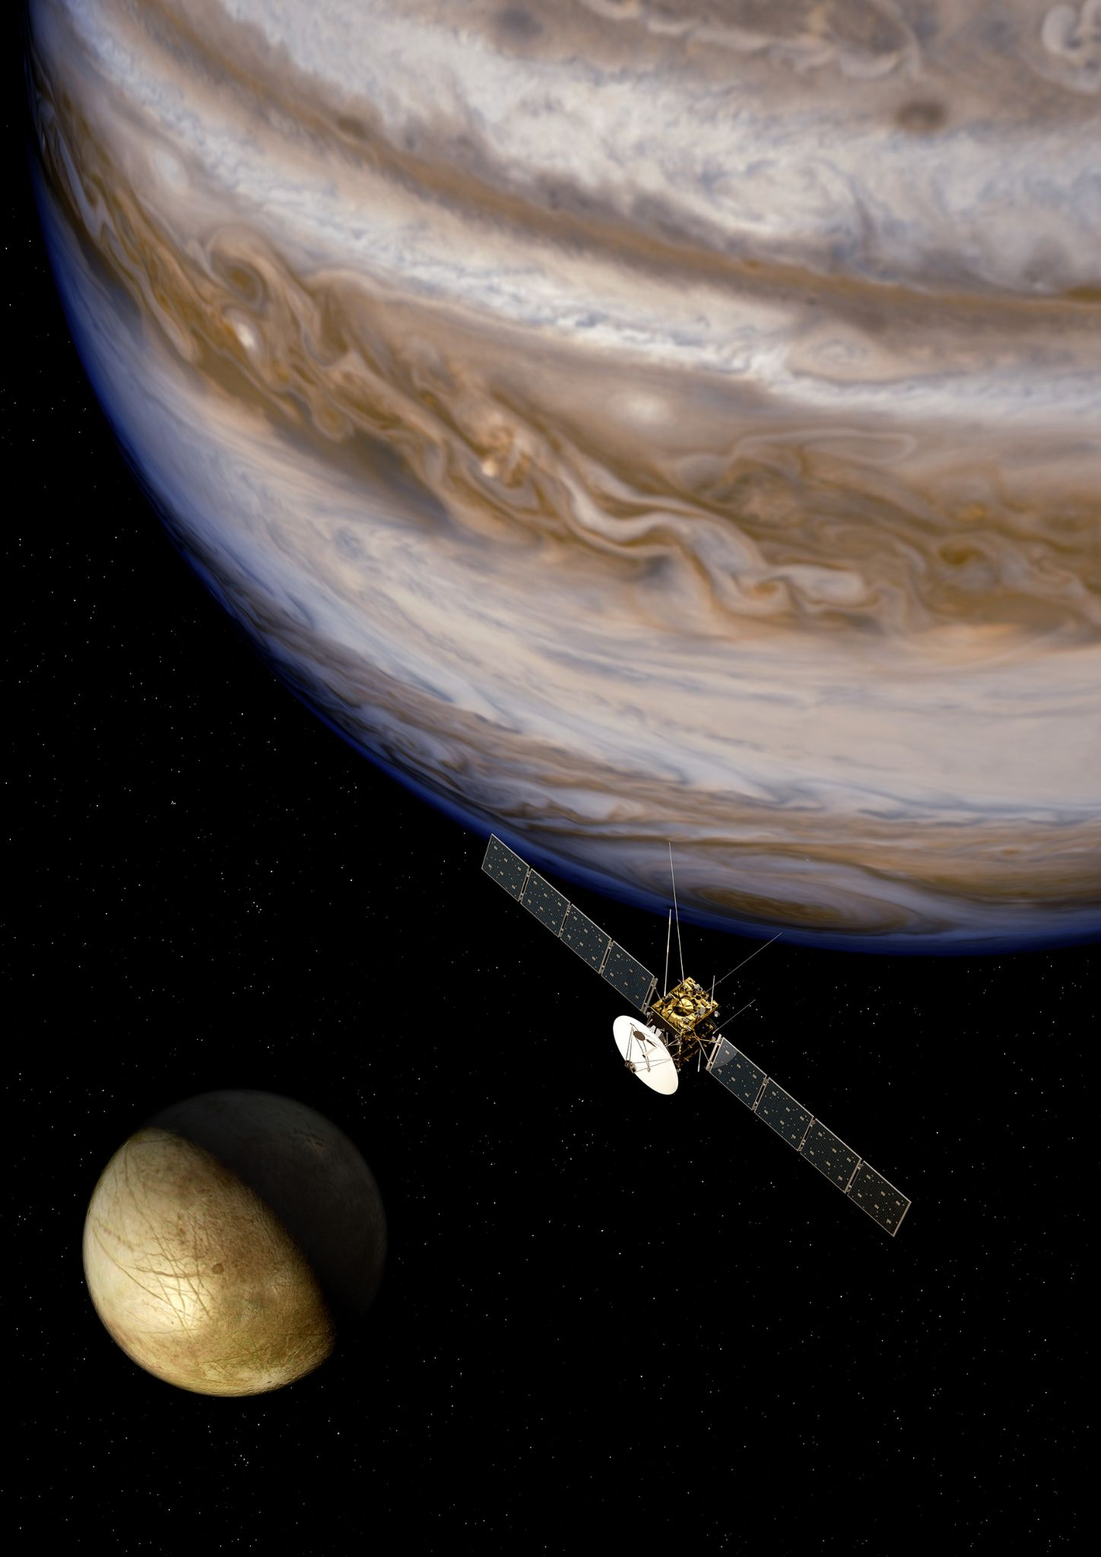
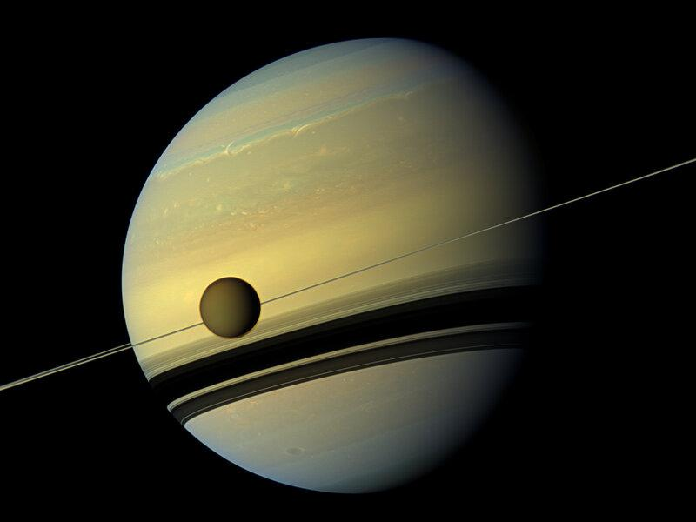
Modularity: Simulations to Fit your Needs
Project Overlook
1
2
3
Graph the Distance Between Two Planets over Time
Record the Traces of Every Body in the Solar System
Calculate How Long it Takes for Two Planets to Eclipse the Other

Slide 5
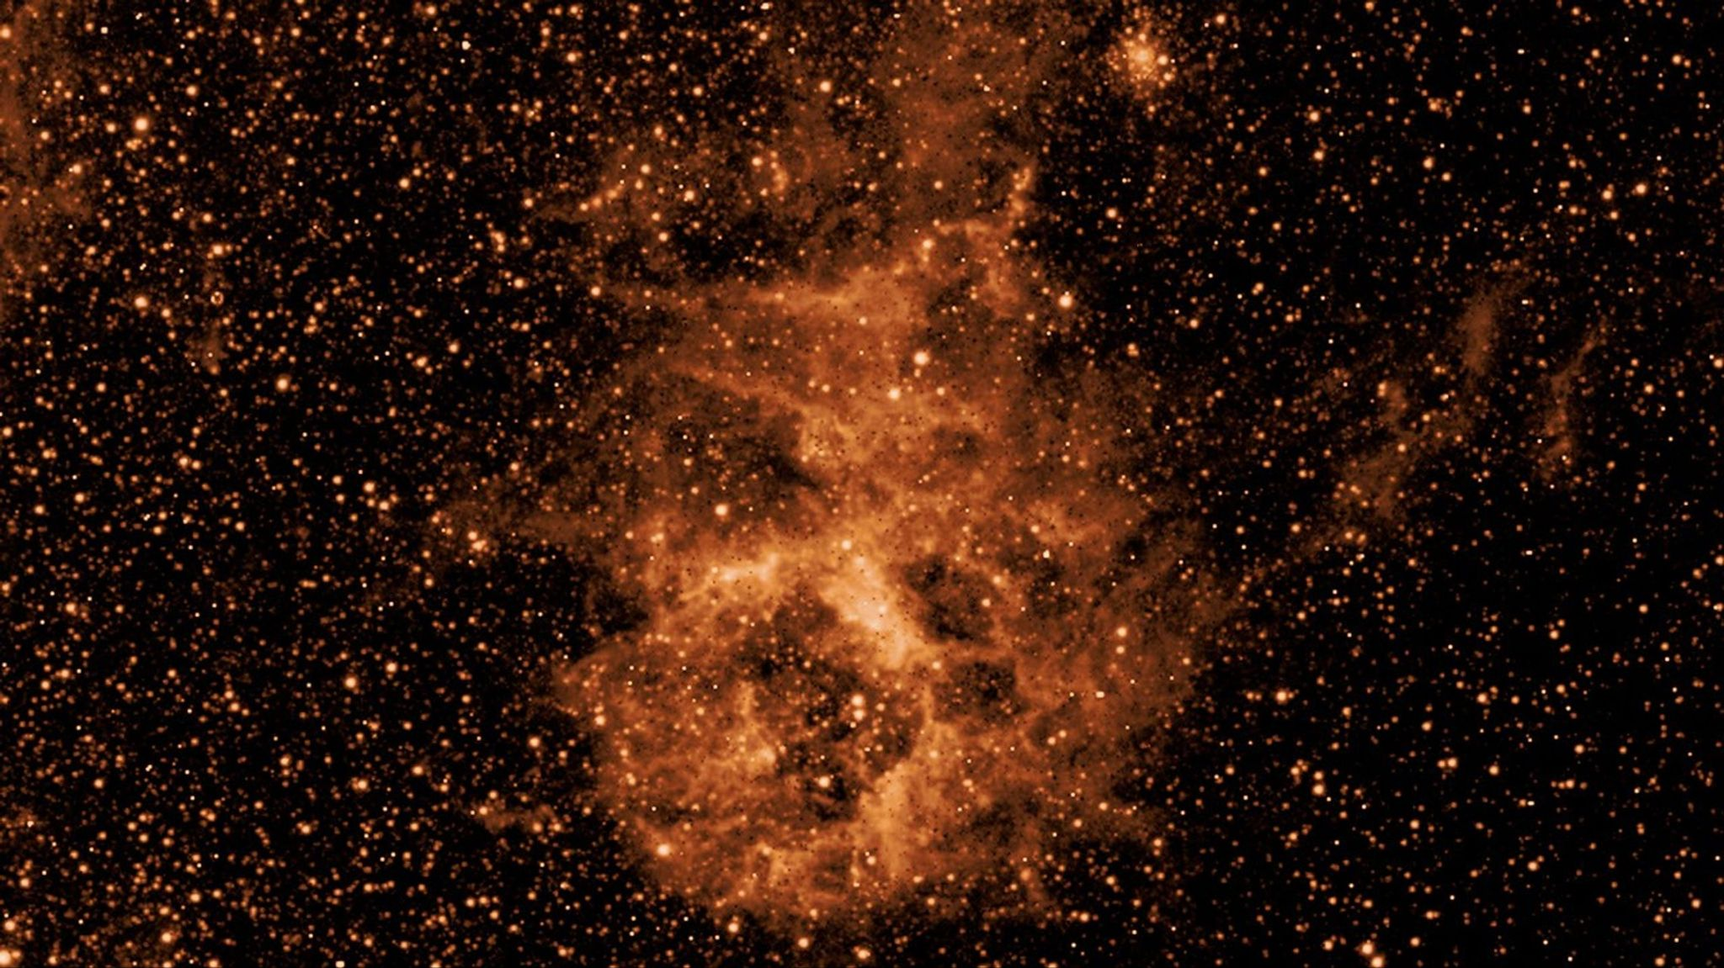
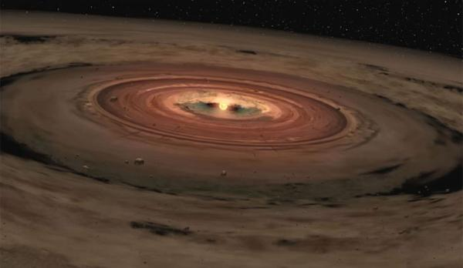
Why Model the Solar System as Flat and not like a Classic Atom?
Proof: 2 Dimensional Coordinates
Huge clouds of dust and particles chaotically orbit each other in 3 dimensions
Particles collide and average their movements until they move in the same direction
Eventually, particles not moving in the “agreed upon” plane correct themselves, and the dust formed rocks and planets

Slide 6
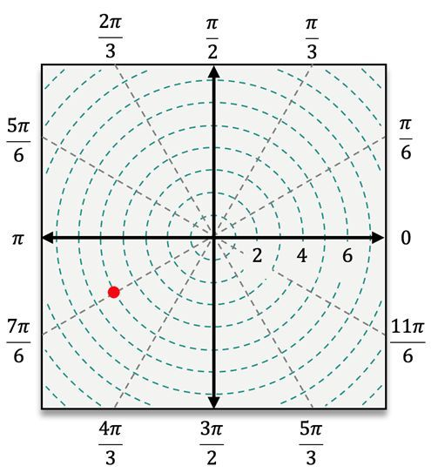
Planets are Easier to Represent as Polar
Proof: Polar vs Cartesian
Polar coordinates use radius and angle instead of x and y to graph points in space
r remains constant, and the parameter for theta can be estimated as a first degree function
Using vector arithmetic, you can calculate the coordinates of a body that doesn’t maintain a constant distance to the origin

Slide 7
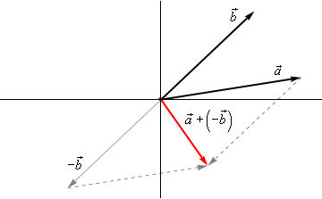
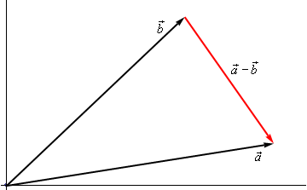


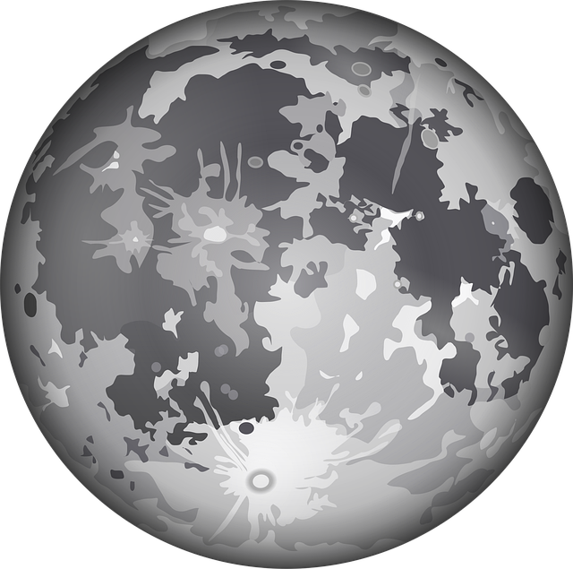
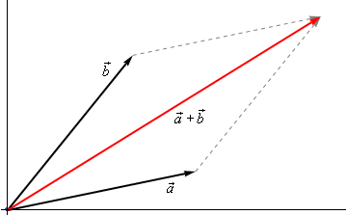
How to Find the Coordinates of a Moon
Proof: Vector Arithmetic
Adding two vectors results in a third vector that is the average of the first two
Subtracting two vectors is the same as adding the negative (opposite) of one vector to the other
a is unknown, but b and (a-b) are known. By adding those two vectors, we can find the b vector
You can convert polar coordinates to cartesian using a simple formula to find X and Y
Distance of Sun to Earth
(constant)
Distance of Moon to Earth
(constant)
Distance of Sun to Moon
(unknown and variable)

Slide 8
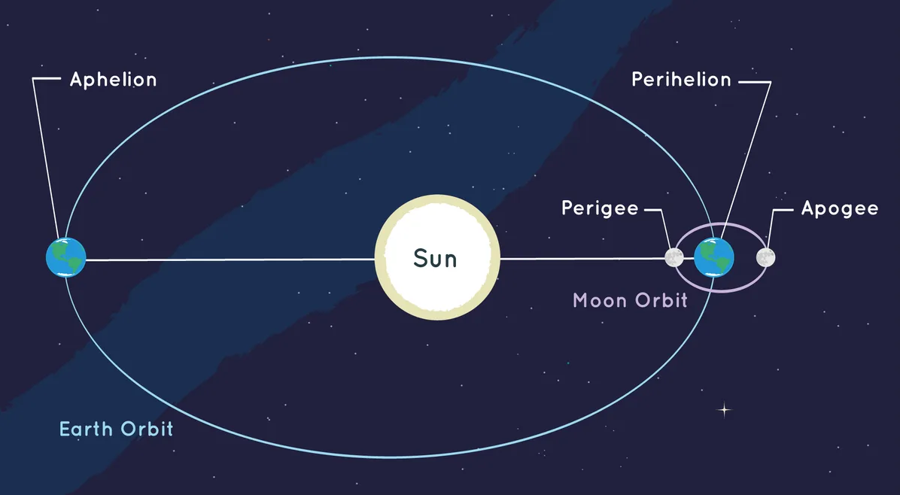

Acknowledgement
Planets follow an elliptical orbit and not a circular one. To maximize accuracy the planets should orbit their own points in Space disconnected from the Sun

Slide 9
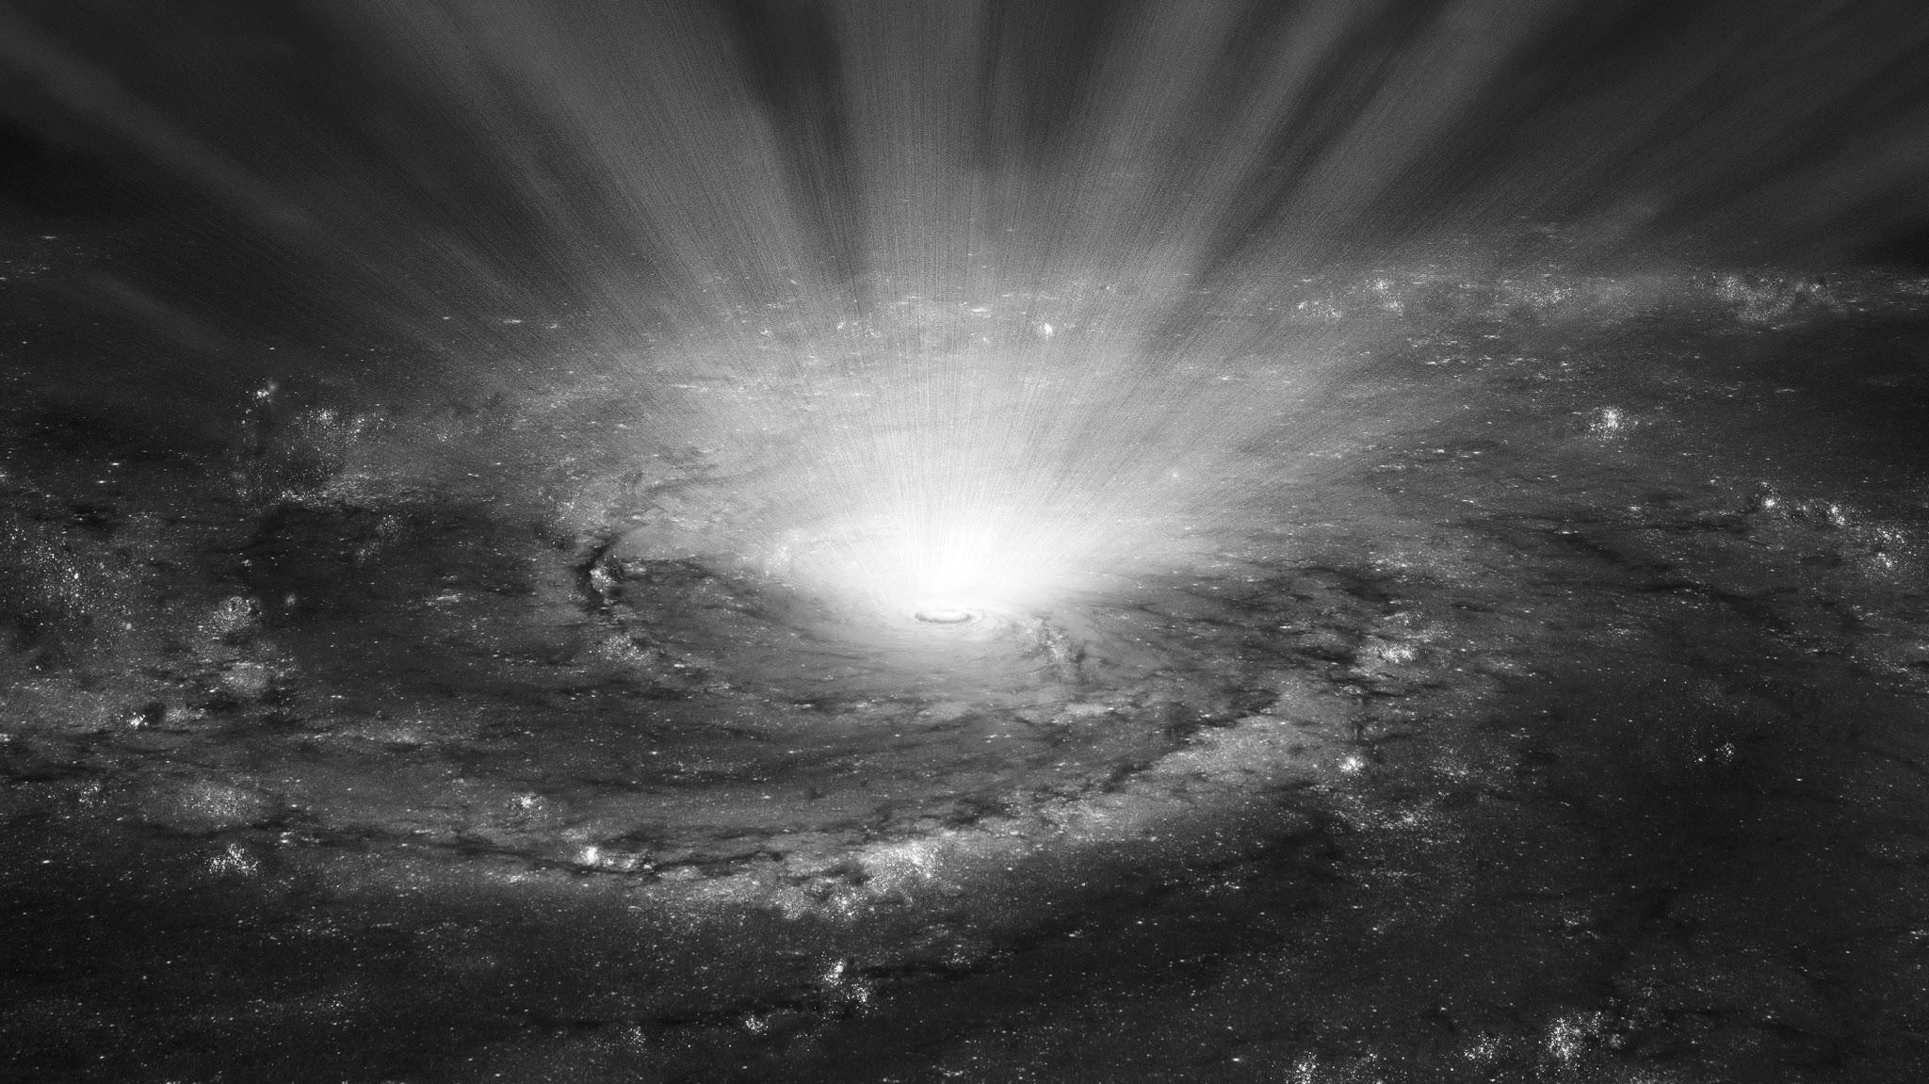
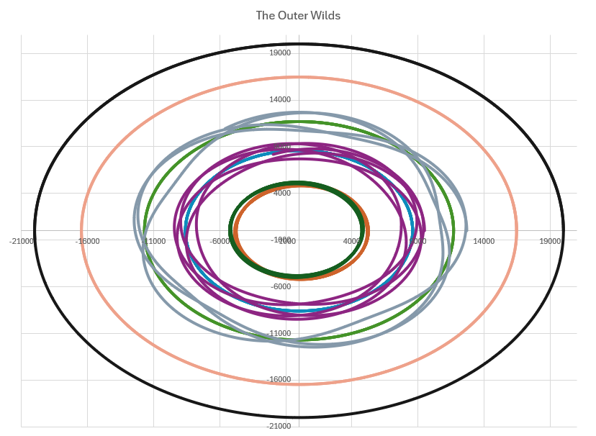
Above are the Traces of the Celestial Bodies in the Outer Wilds
Results
sun

Slide 10
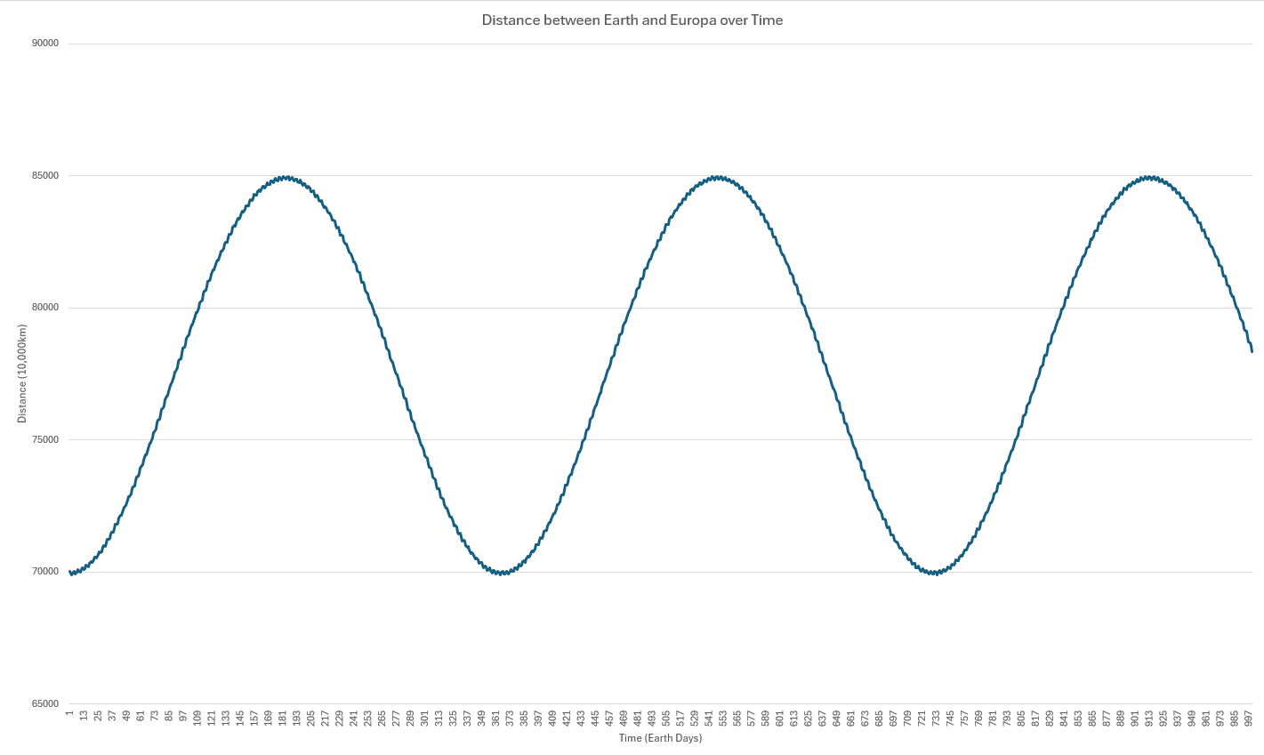
Note the Jagged Line. The Graph Appears Sinusoidal, but it is actually a Sum of Waves
Results

Slide 11
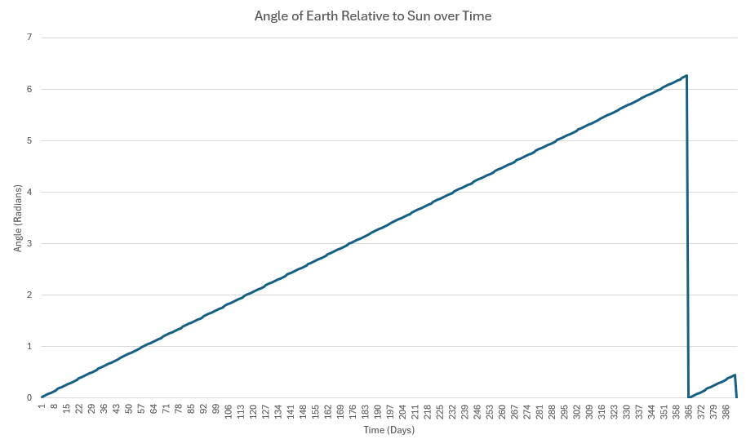
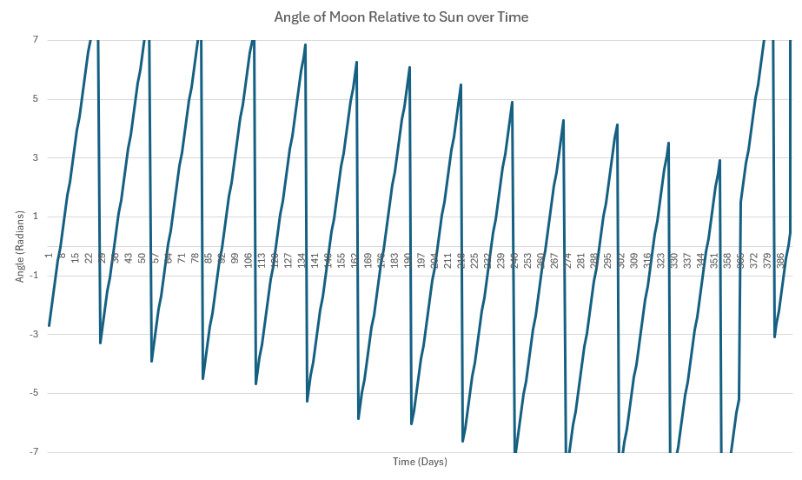
The Sharp Change Represents a Finished Orbit around the Sun. It Took 391 Days for the Moon to Eclipse the Sun for Earth
Results

Slide 12



My Experience in
Computer Science
Conclusion
Challenges:
Thinking about data in relation to other points but also in relation to an origin
How to initialize an object that requires another object of the same type
Prioritizing function, accuracy, modularity, and difficulty
Thank you for paying attention to the presentation. If you are interested in the program I have linked the github repository.
A copy of this presentation will also be included in the github.
https://github.com/AidanAyerslol/SolarSystem

